Slide 1

Online health care management system

Slide 2
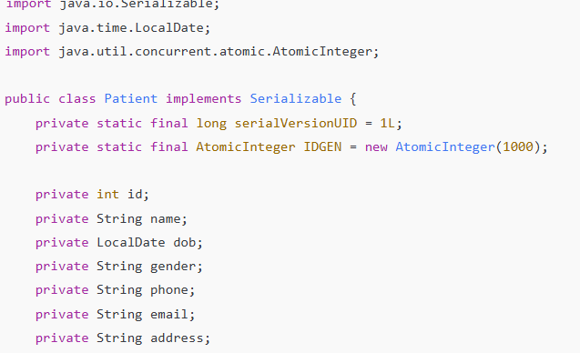
PROBLEM STATEMENT &PROJECT OBJECTIVES
Hospital activities like patient registration, appointments, and billing are handled manually, causing delays and errors.
Medical data is not centralized, making it difficult for doctors and staff to access patient information quickly.

Slide 3
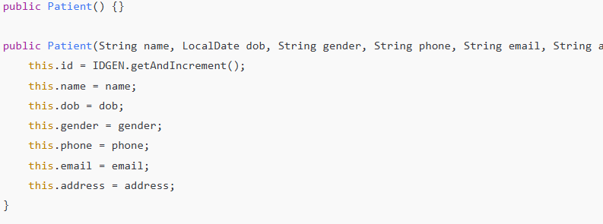
PROJECT CODE AND ISSUES
Poor coordination between departments leads to inefficiency and slow service.
Lack of automation results in time-consuming processes and low accuracy.
There is a need for a secure system to store and manage patient and hospital data effectively.

Slide 4
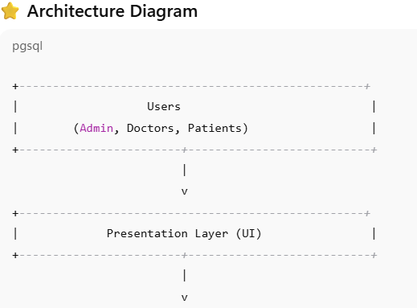
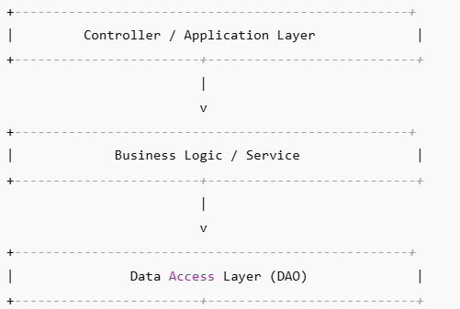
1. Presentation Layer (User Interface)
This is what the user interacts with.
Responsibilities:
Show forms, dashboards, appointments, reports.
Take user inputs.
.Technologies (example): JSP, HTML, CSS, JavaFX, or frontend pages.

Slide 5
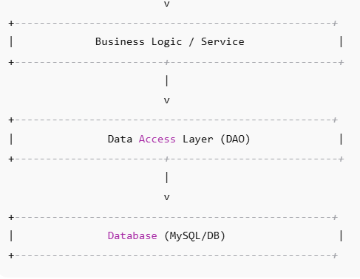
2. Application / Controller Layer
All incoming requests from UI.
Communicates between UI and business logic.
Validates requestsHandles.

Slide 6
3. Business Logic Layer (Service Layer) Core logic of the system is here: Create or manage patient records. Schedule appointments. Update doctor availability. Billing and prescription. 4. Data Access Layer (DAO Layer) Manages communication with database: Insert, update, delete, retrieve data. Uses JDBC or ORM.
5. Database Layer
Stores system data in a structured format.
Example tables:
patient
doctor

Slide 7
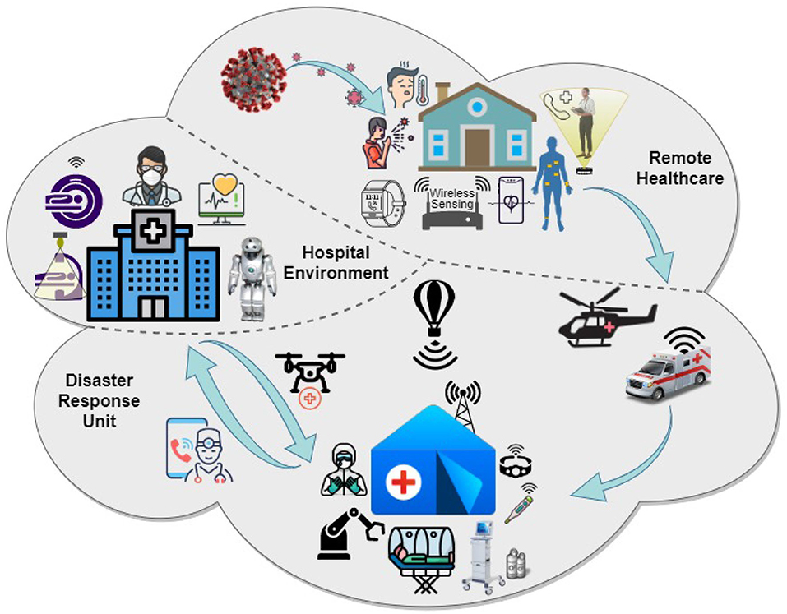
⭐ DISCUSSION
The system replaces manual hospital work with an automated process.
Centralized data storage makes accessing patient records fast and easy
.
The architecture improved efficiency, data accuracy, and speed.
The system helps in better coordination between doctors, staff, and patients.
Overall, digitalization improves healthcare service quality and reduces errors.
This Photo by Unknown Author is licensed under CC BY

Slide 8
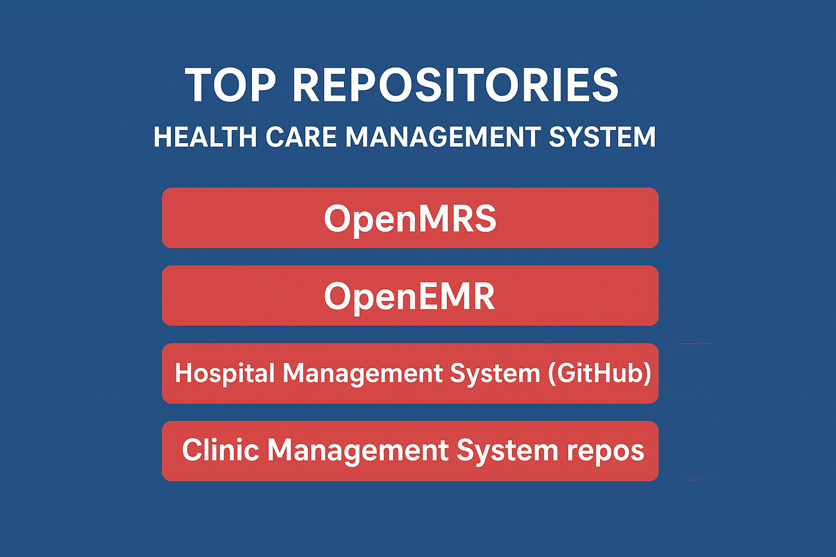
# Recommended Repositories / Projects
OpenMRS – A popular open-source hospital and medical record system made in Java.
OpenEMR – A complete electronic medical record and health management platform.
Hospital Management System (GitHub) – Java-based hospital automation project for appointments and patients.
Clinic Management System repos – Provide modules for doctors, patients, and billing.

Slide 9
# ORGANIZATIONS
WHO (World Health Organization) – Works globally on public health improvement.
UNICEF – Supports child health, vaccination, and medical programs.
Red Cross – Provides emergency medical services and disaster relief.
NHA (National Health Authority – India) – Manages national digital health and insurance systems.
CDC (Centers for Disease Control) – Prevents and monitors disease outbreaks.

Slide 10
STARRED
# Manages healthcare services efficiently for patients and staff. # Aims to improve patient care and optimize hospital operations. # Includes modules like Patient, Staff, Inventory, Billing, and Analytics. # Uses technology such as HMS, EHR, and Telemedicine for automation. # Ensures faster service, cost reduction, and better patient satisfaction.

Slide 11
THANK YOU
SUBITTED BY:-
IRFAN AHMAD ANSARI
(24SCSE1420066)
AYUSH KUMAR SINGH
(24SCSE1420059)
This Photo by Unknown Author is licensed under CC BY

